Slide 1



Burger’s Equation
Vinh Huynh

Slide 2
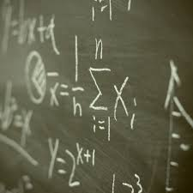
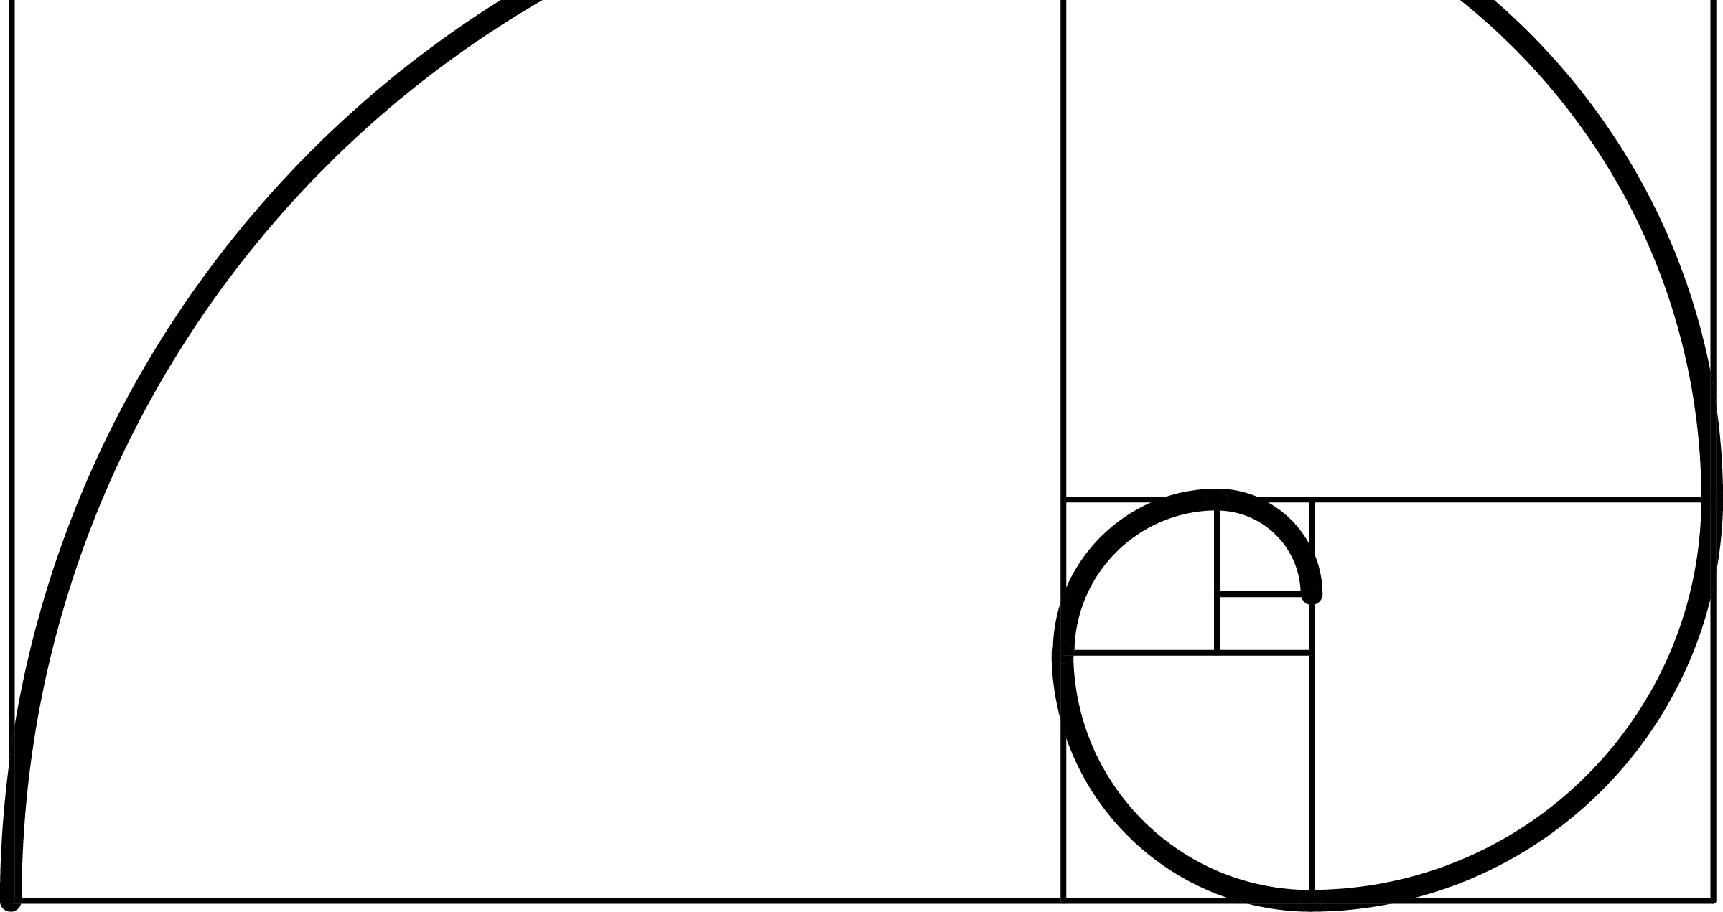
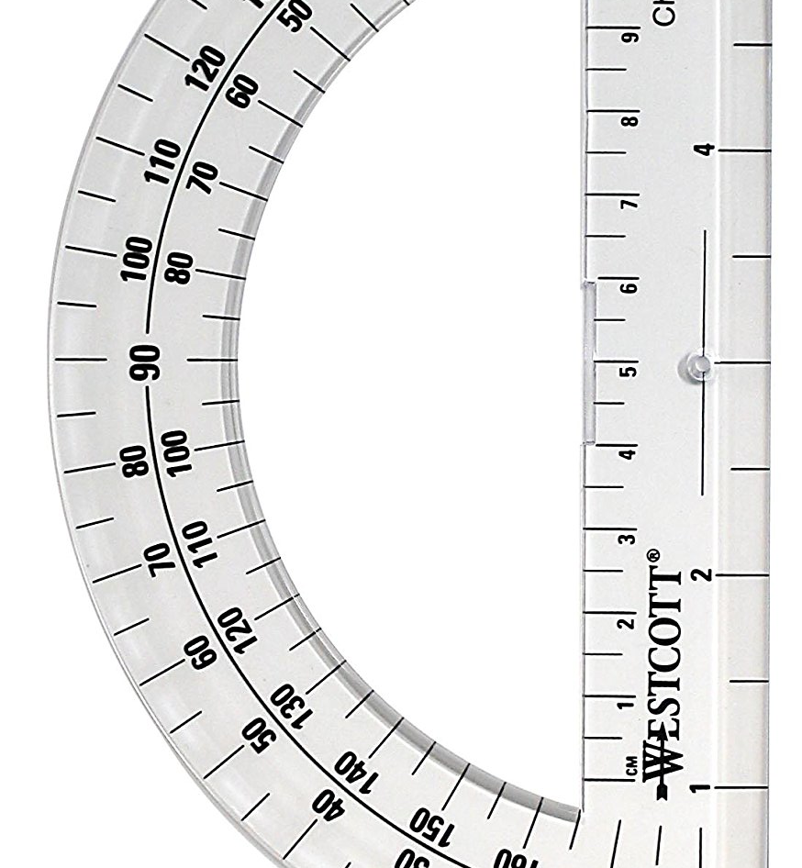
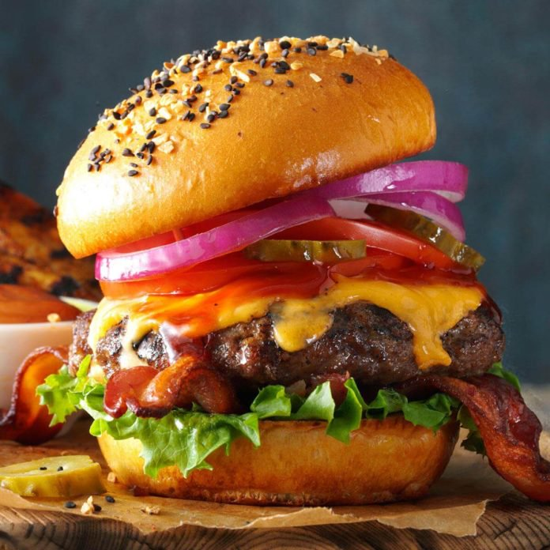
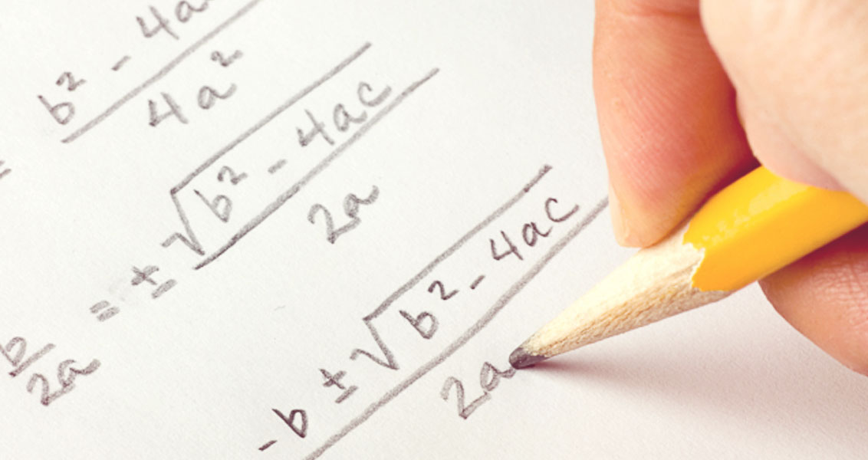
What is the Burger’s Equation?

Slide 3
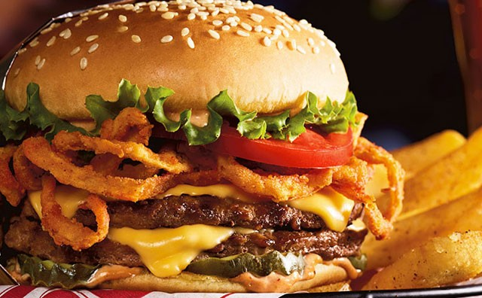
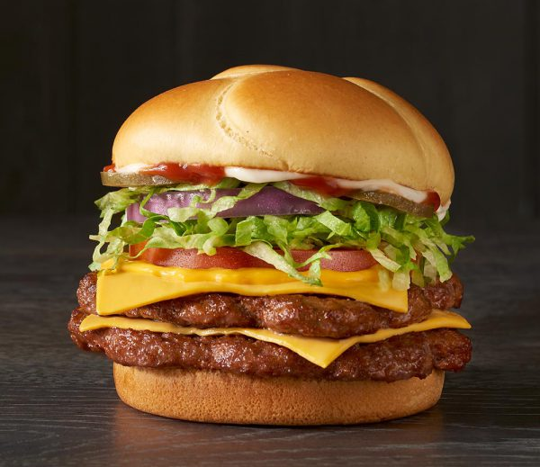

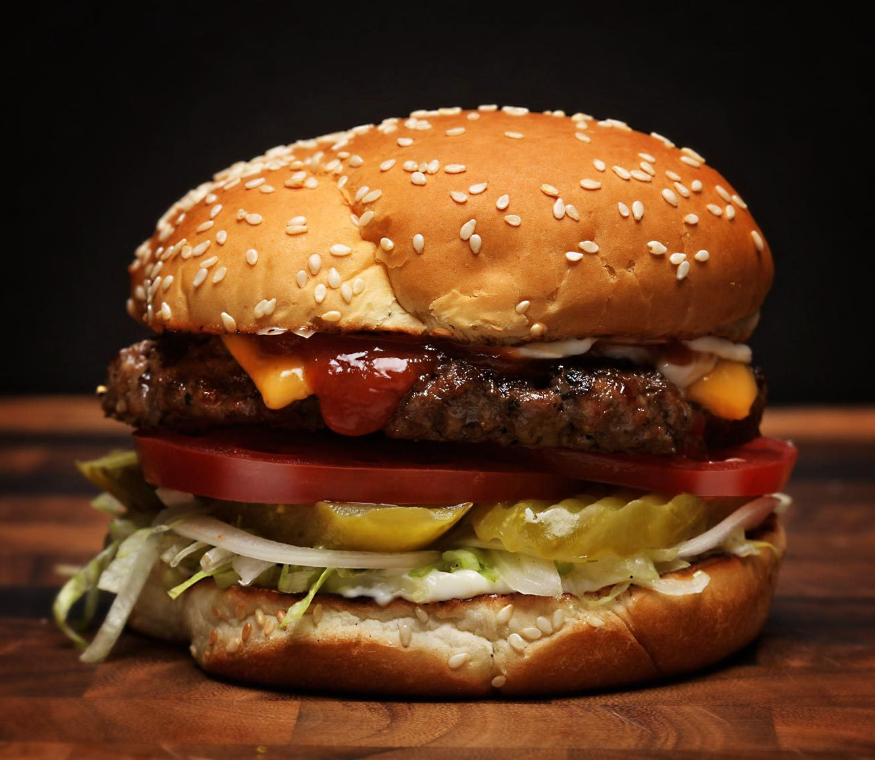
Machine Learning Algorithms!

Slide 4


Conclusion

Slide 5

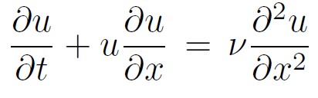
What is the Burger’s Equation Pt. 2

Slide 6
WHAT DOES IT EVEN MEAN

Slide 7

J.M Burgers
A simple model for the study of turbulence
The fixed parameter v is analogous to the viscosity of a fluid

Slide 8
Viscosity of the fluid

Slide 9
Viscosity Definition
“A quantity expressing the magnitude of internal friction, as measured by the force per unit area resisting a flow in which parallel layers unit distance apart have unit speed relative to one another”
Viscosity of the fluid
-Google Dictionary Definition

Slide 10
Viscosity Definition
“How thick a fluid is”
-Vinh Huynh
Viscosity of the fluid

Slide 11
The “Extra Term”

Slide 14

Looks familiar?

Slide 15
It’s almost as if someone taught us something like this…

Slide 16

It’s almost as if someone taught us something like this…

Slide 17
It’s just the Diffusion Equation!

Slide 18
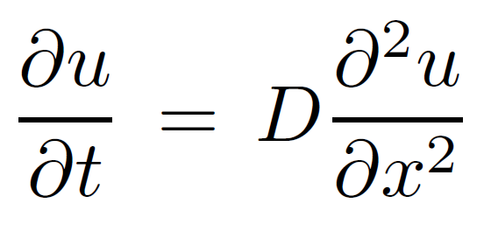

Slide 19
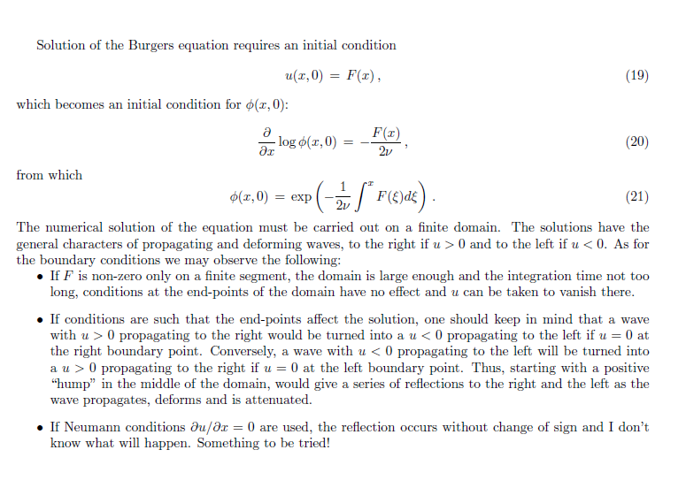
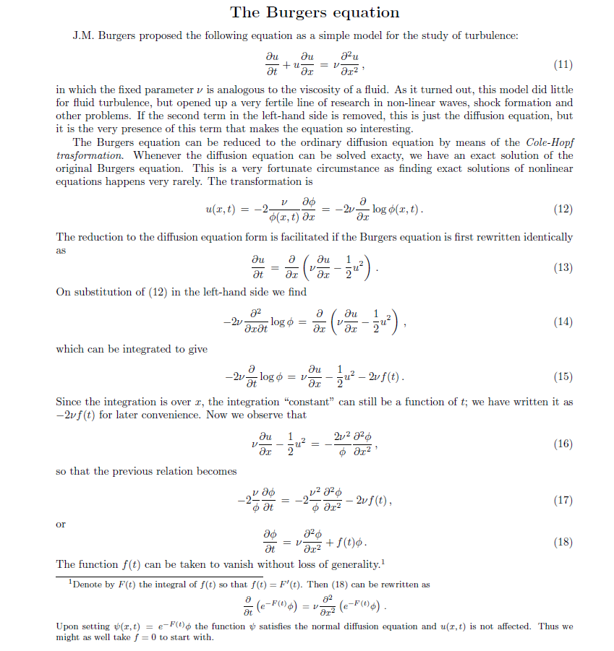
How did I even start from there?
So I just read the pdf Dr. Prosperetti provided
I realized that had I read this pdf first instead of spending a few years of my life calculating the ideal burger, I would have save so much time

Slide 20
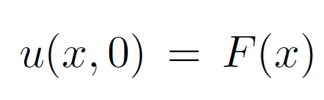
After reading the pdf…
Burger’s Equation requires an initial condition

Slide 21
After reading the pdf…
Burger’s Equation requires an initial condition
So I just filled a vector with a bunch of zeros

Slide 22
But I didn’t know how to calculate the next term yet…

Slide 23
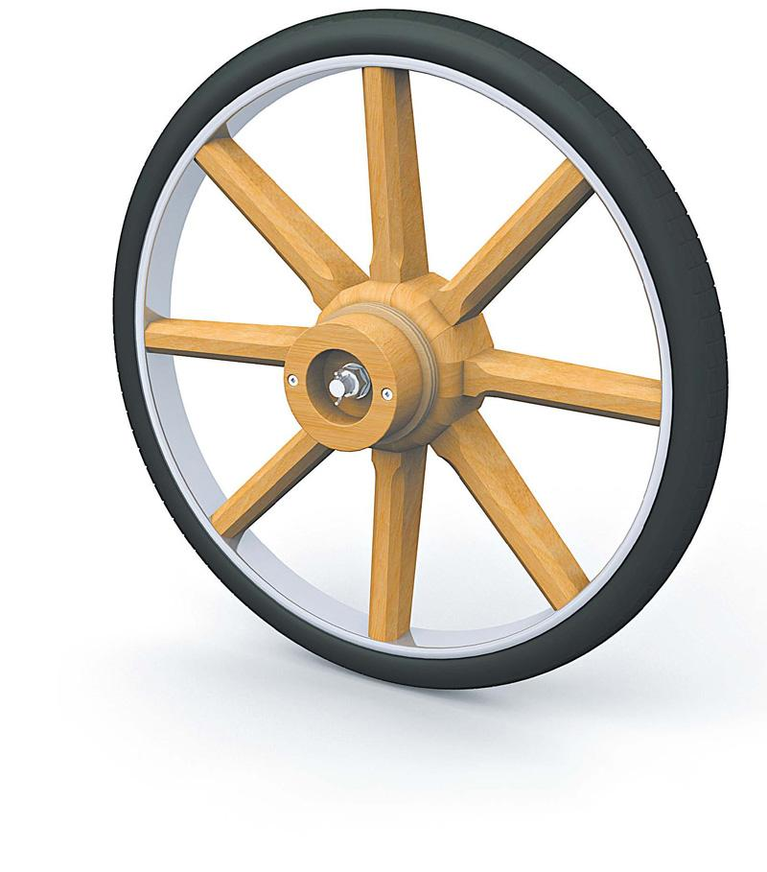
But I didn’t know how to calculate the next term yet…
So I decided to reinvent the wheel

Slide 26
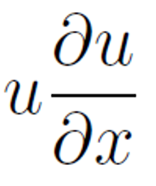

Slide 27
Multiply the equation by dt

Slide 28



( )

Slide 29
( )
You should praise me because I used snip to cut the image and separated the terms over and over again.

Slide 30
( )
So what happened?

Slide 31
Switching over to MatLab…

Slide 32
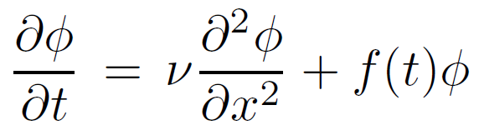
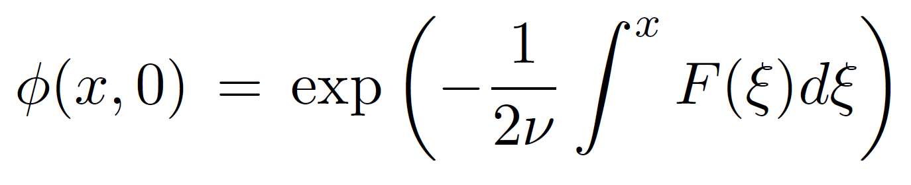
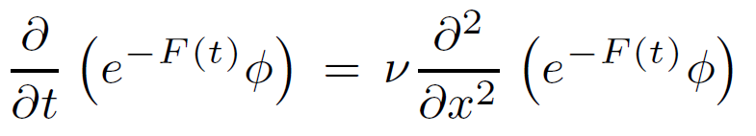
Then I saw these equations!

